Slide 1
BBTools
~20 shell scripts support all stages of NGS analysis from evaluating raw reads through de novo assembly.
“BB stands for Bestus Bioinformaticus”
authored by Brian Bushnell
Released Feb. 19, 2014
http://sourceforge.net/projects/bbmap/
http://jgi.doe.gov/data-and-tools/bbtools/bb-tools-user-guide/usage-guide/
http://seqanswers.com/forums/showthread.php?t=58221

Slide 2
BBTools
~20 shell scripts support all stages of NGS analysis from evaluating raw reads through de novo assembly.
written in Java
all scripts share a common syntax
processes compressed files
automatically detects common file formats, quality encoding & paired reads
well-documented & regularly enhanced
author promptly answers questions on SEQanswers
unpublished, most algorithms not described
by default, the program will use all available memory and processors
To specify 1 processor & 2 Gb RAM: t=1 Xmx2g

Slide 3
http://1ofdmq2n8tc36m6i46scovo2e.wpengine.netdna-cdn.com/wp-content/uploads/2013/11/BB_User-Meeting-2014-poster-FINAL.pdf

Slide 4
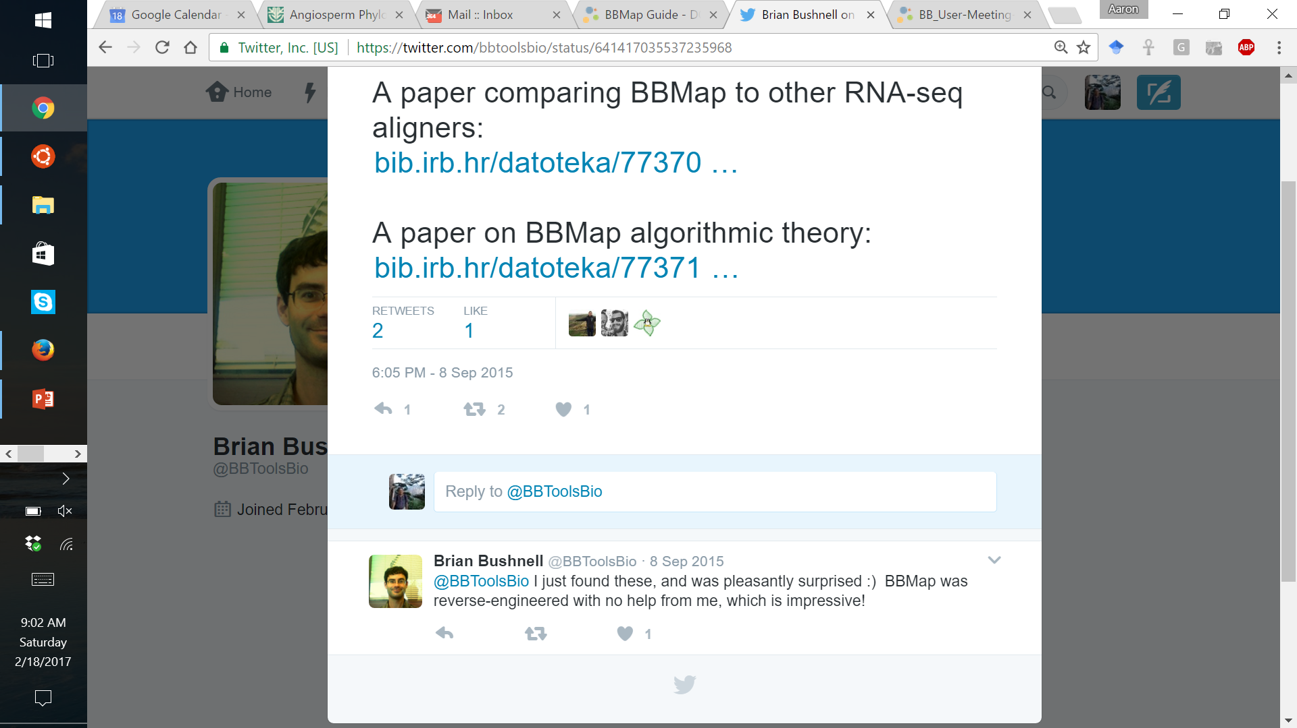

Slide 5
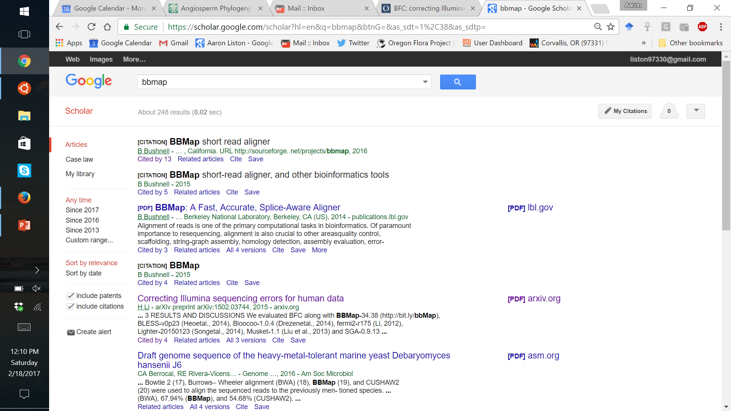
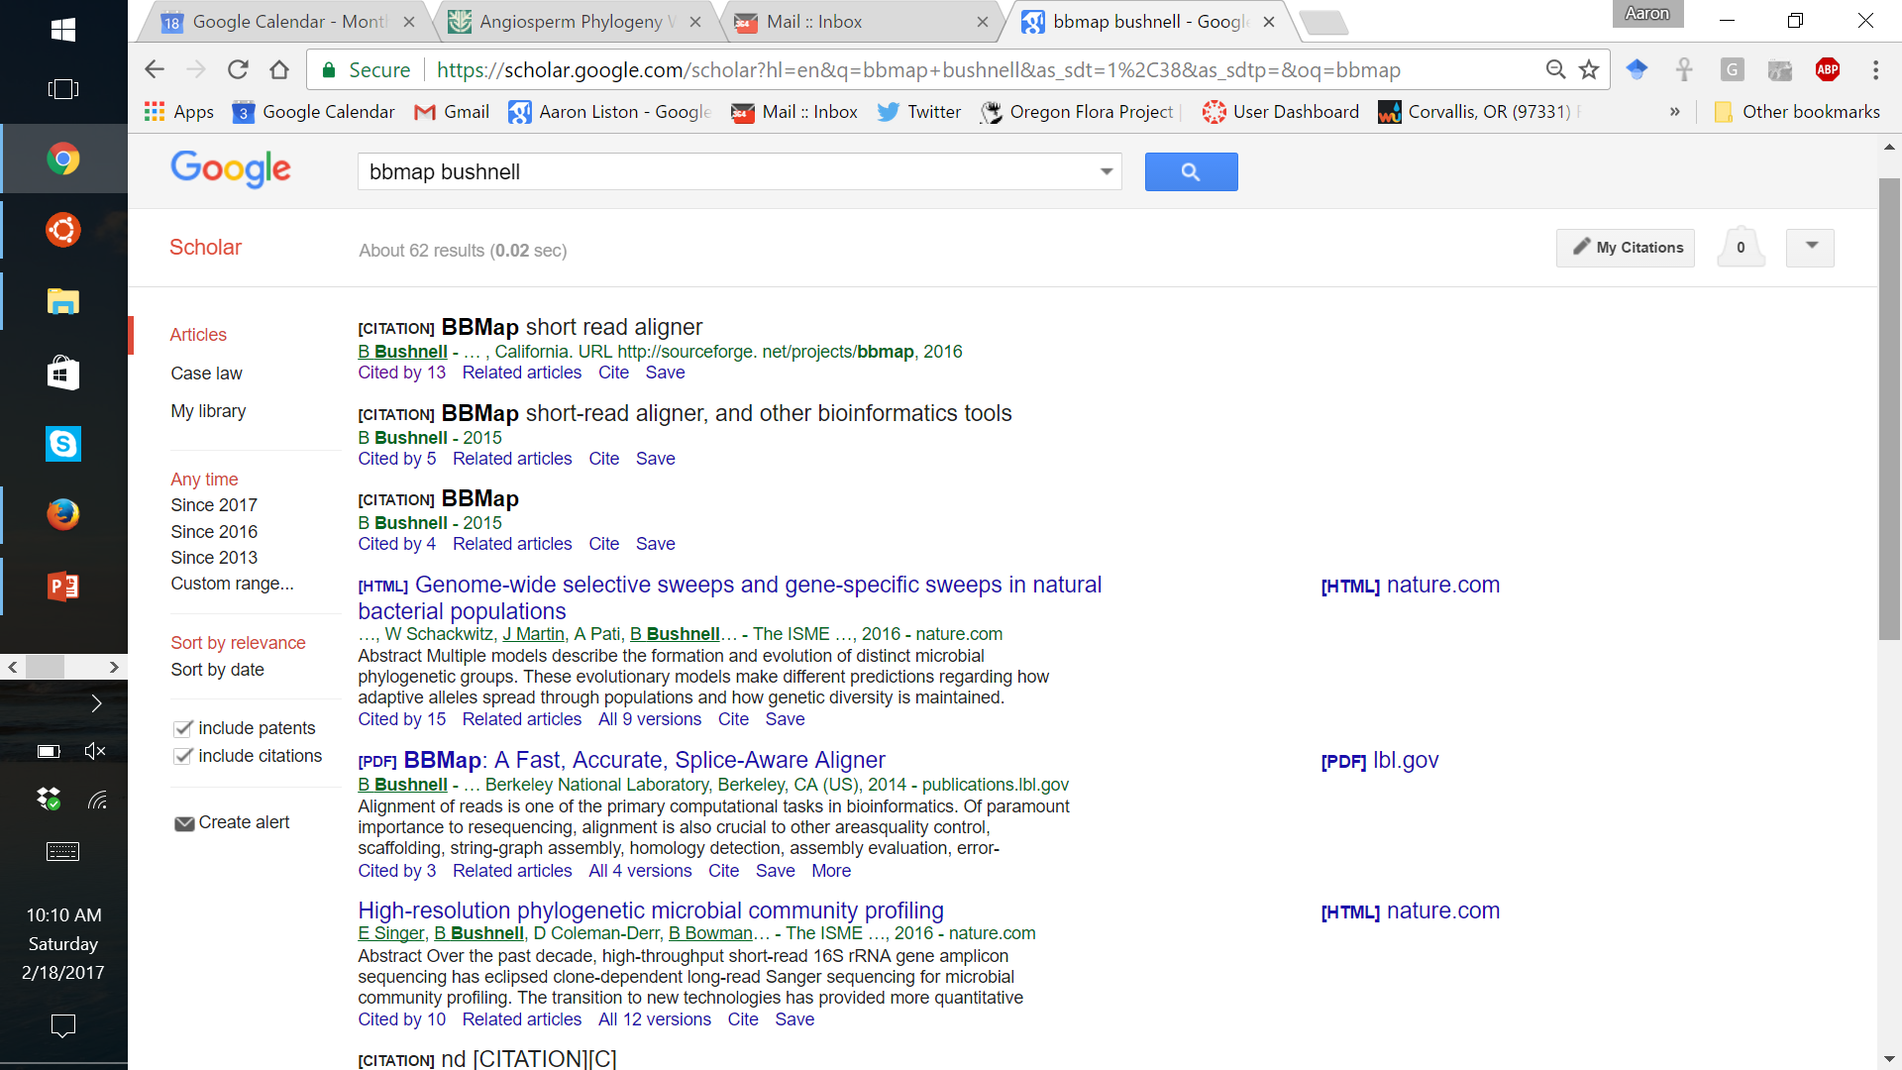

Slide 6
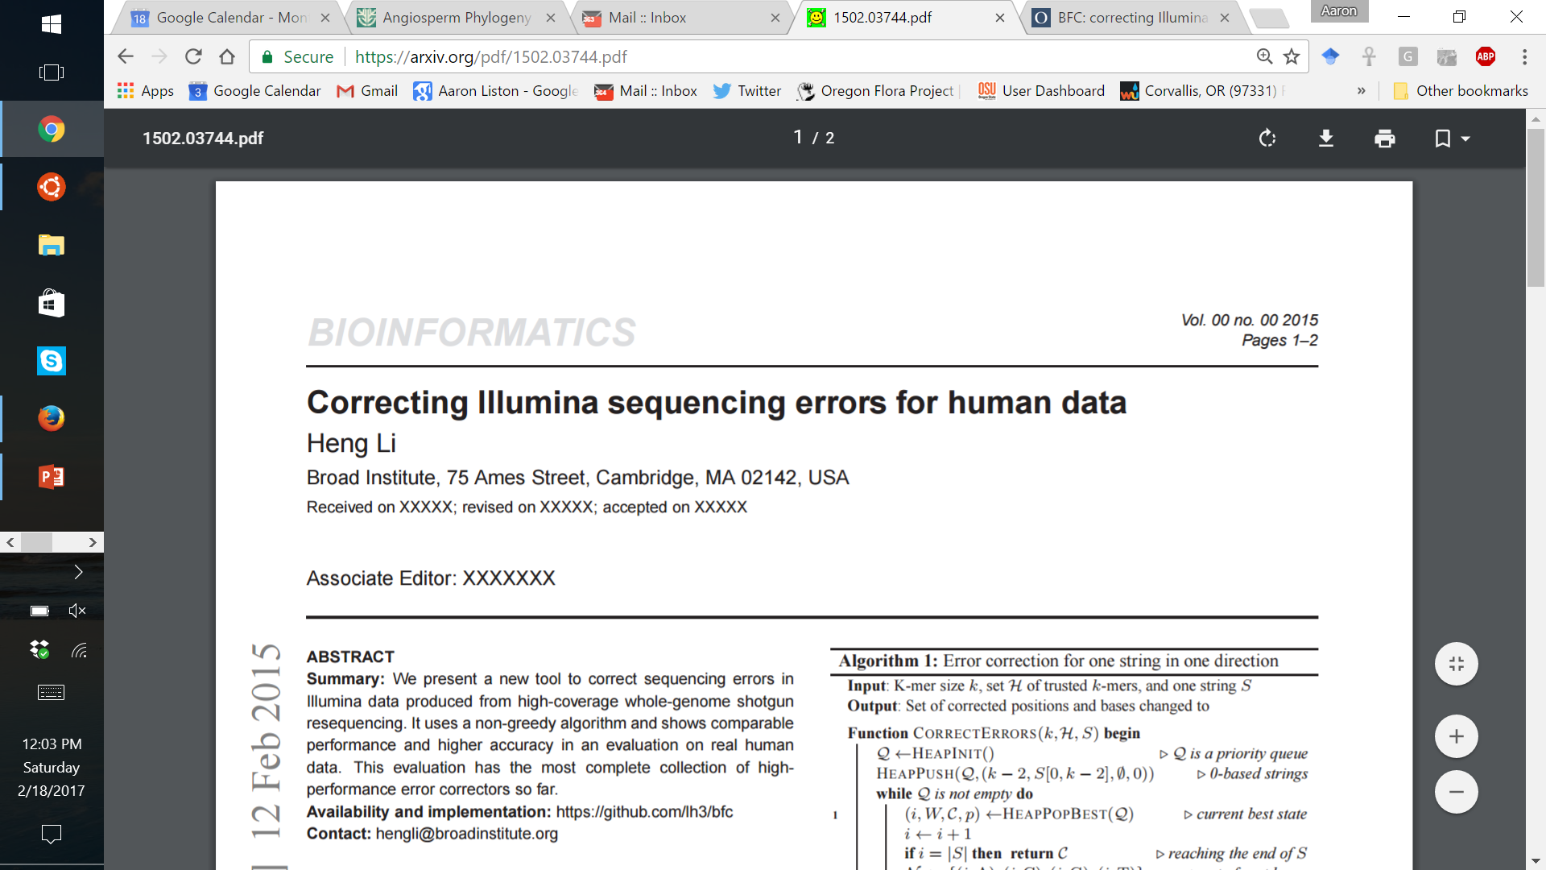
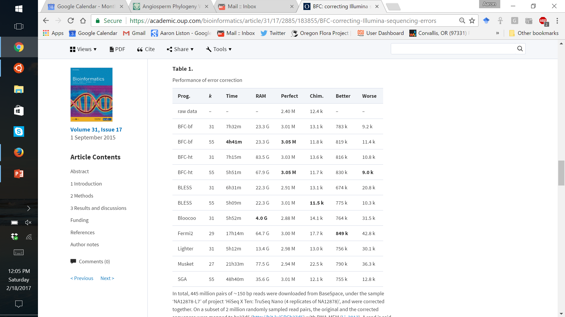
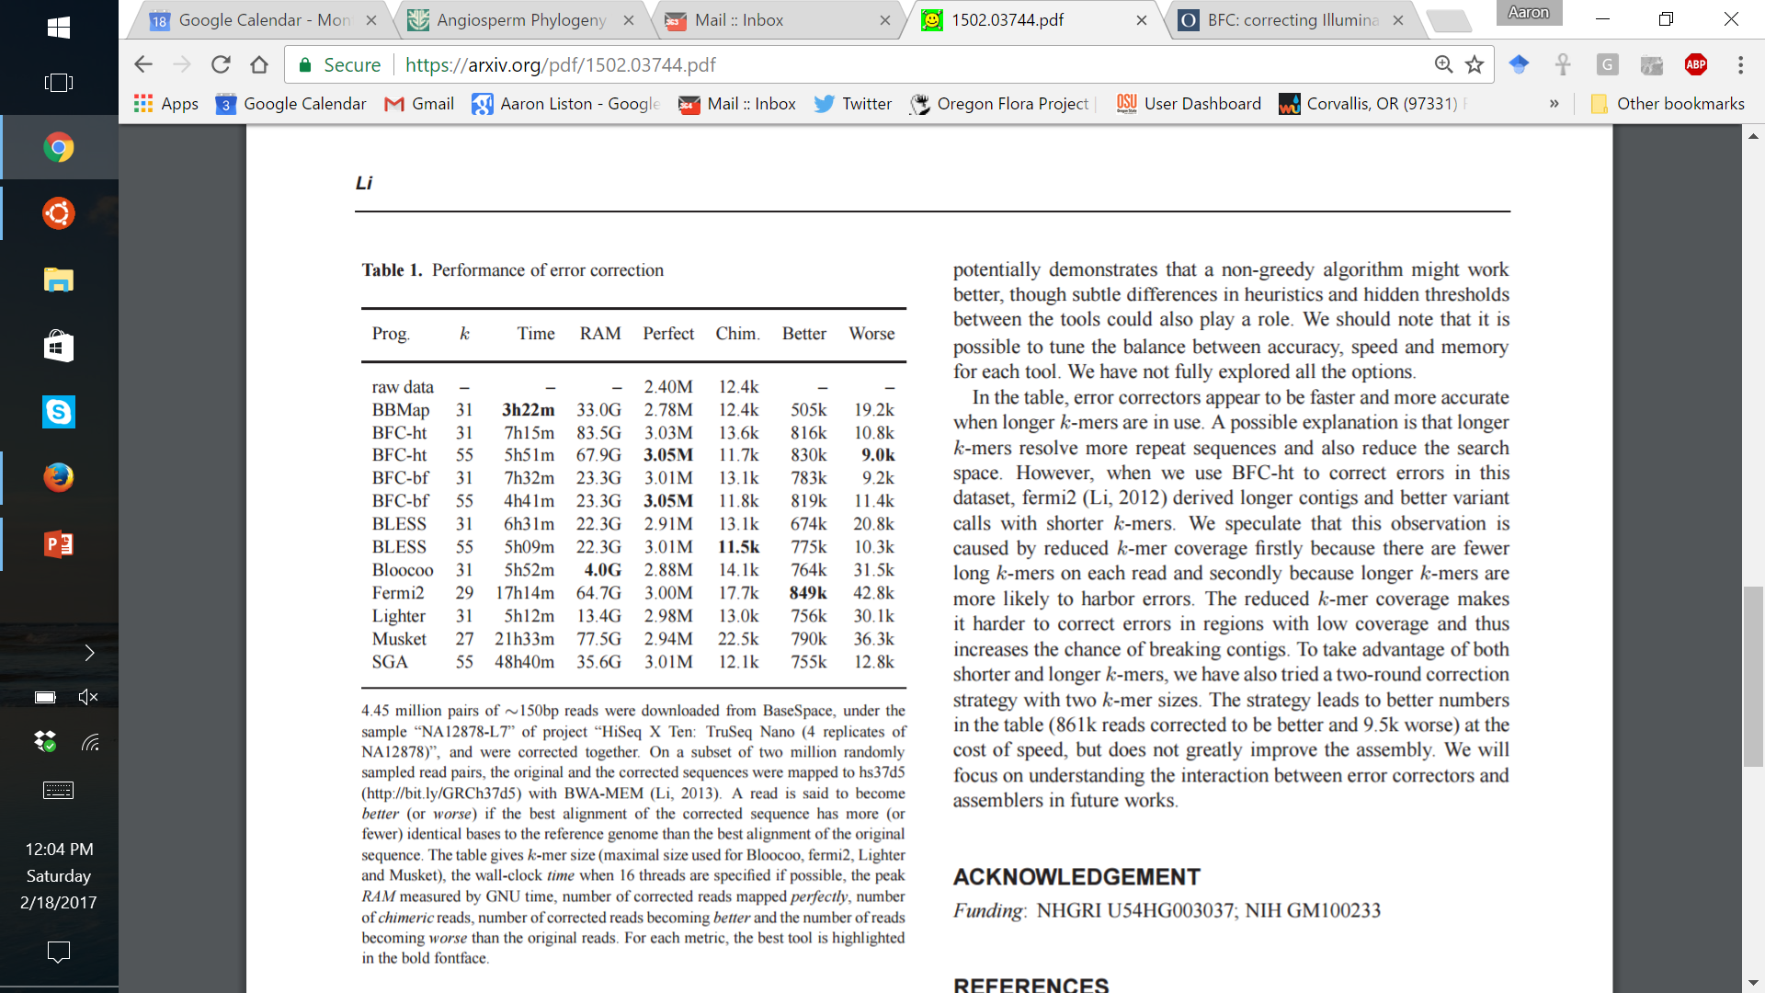

Slide 7


Slide 8
Sequence Processing
Step BBTools script
0. Format Conversion reformat.sh
Adapter Trimming bbduk.sh
Contaminant Filtering bbduk.sh or bbmap.sh
Deduplication dedupe.sh
Normalization / Subsampling bbnorm.sh or reformat.sh
Error Correction tadpole.sh or bbnorm.sh
Paired Read Merging bbmerge.sh
kmer Depth Distribution bbnorm.sh or khist.sh

Slide 9
0. Format Conversion
reformat.sh
Reformats reads to change ASCII quality encoding, interleaving, file format, or compression format. Optionally performs quality trimming, subsetting, and subsampling.
Supports sam, bam, fastq, fasta, fasta+qual, scarf, gzip, zip.
Format specified by extensions.
To view all options, run shell script with no parameters.
Usage:
reformat.sh in=<file> in2=<file2> out=<outfile> out2=<outfile2>
If input is paired and there is only one output file, it will be written interleaved.

Slide 10
1. Adapter Trimming & 2. Contaminant Filtering
bbduk & bbduk2 (decontamination using kmers)
Uses kmer matches and reference sequence to:
filter contaminants kfilter (default)
trim adapters (left or right) ktrim
mask sequence kmask
Can filter by:
quality (also trim)
GC-content
entropy
length (after trimming)
Outputs histograms:
quality, length, GC-content

Slide 11
3. Deduplication
dedupe (best for longer sequences – functions of cdhit)
clumpify sorts sequences by similarity; orig. for compression deduplication added in Jan. 2017
marks or removes optical or all duplicates
Optical duplicates = split clusters (patterned flow cells)
PCR duplicates from “enrichment” step of library prep
Deep sequencing (>500X) will result in “natural duplication”
Should duplicates be removed? Differences of opinion exist:
See Zhou et al. 2014. Bioinformatics. 30: 1073–1080.

Slide 12
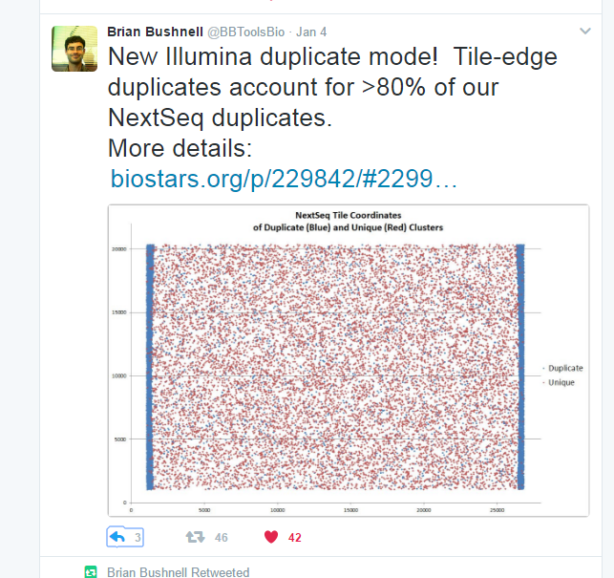

Slide 13
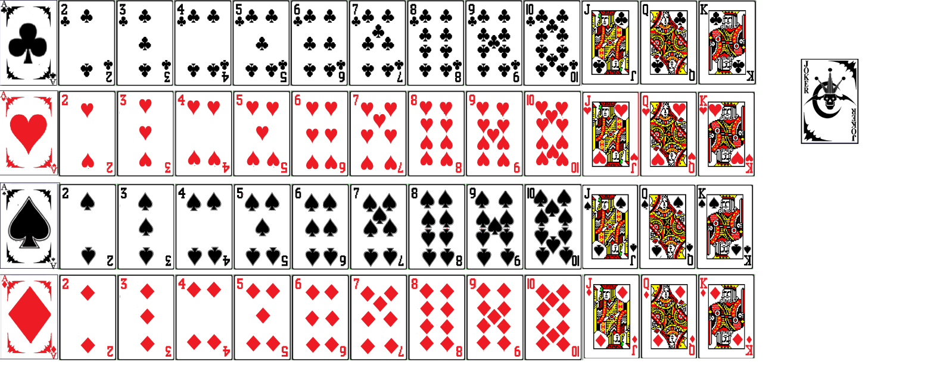

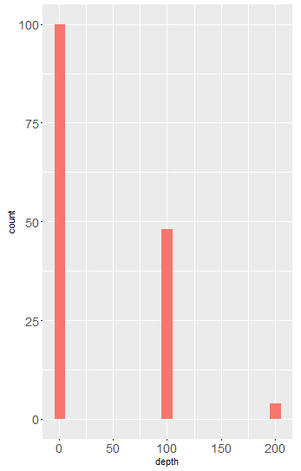

kmercountexact
Counting k-mers
single copy
count
2X repeat
repeat 100 times, with one unique error each time
error
depth

Slide 14
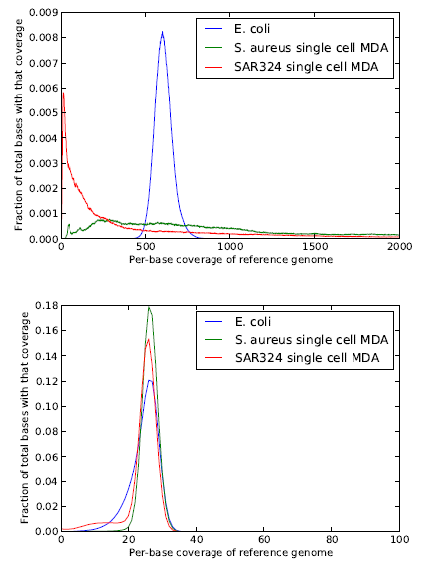
4. Depth Normalization
bbnorm
Normalizes read depth based on k-mer counts
Retains nearly all real k-mers & discards majority of error k-mers.
Reduces # of over-represented k-mers (duplicates, repeats).
Used for very high or uneven coverage libraries (e.g. single cell).
Can rescue bad libraries.
before
after
Crusoe et al (2015) The khmer software package: enabling efficient nucleotide sequence analysis. F1000Research 4: 900.

Slide 15
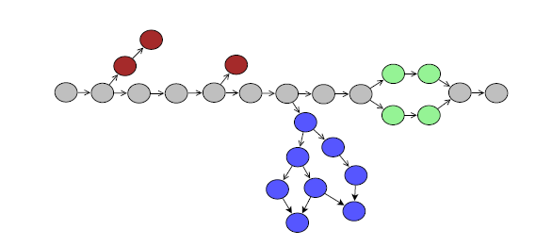
5. Error Correction
tadpole
Kmer-based assembler
de Bruijn graph
tips = errors
bubble = heterozygosity
loops =
repeats
© 2014 Jared Simpson

Slide 16
5. Error Correction
tadpole
Very conservative & optimized for correctness not length.
Design goals were for read extension and error-correction for paired read merging.
Stops at every branch, and condenses every repeat. Does not scaffold.
Tip removal with “shave” and Bubble removal with “rinse.”
“pincer” and “tail” algorithms for correcting read middle & end.
Can assemble a coverage “band”, e.g. 500-1000X, potentially useful for symbionts, organelles, etc.

Slide 17
6. Paired Read Merging
bbmerge
Try to merge each pair of reads via overlap.
If they don’t merge, error-correct with tadpole & try again.
If they still don’t merge, extend each read by 20bp (stopping early if a branch is encountered) and try again; repeat at most 10 times.

Slide 18
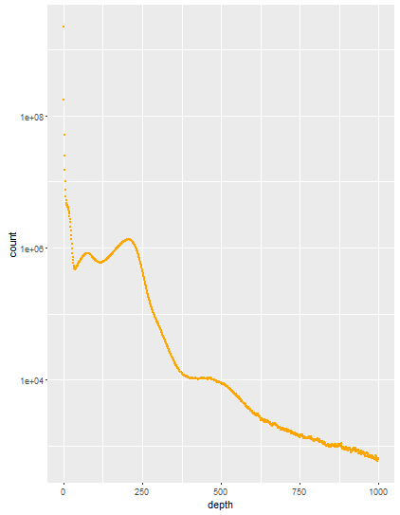
7. Kmer Depth Distribution
bbnorm or khist
V1 = volume of peak 1, V2 = peak 2, V3 = peak 3, ...
P1 = round (Dn / D1), Dn = peak n max.
diploid genome size = V1*P1 + V2*P2 + V3*P3 + ...
singletons
= error
homozygous
=2x in genome
heterozygosity
= 1X in genome
repeats > kmer length

Slide 19
bbmap
“splice-aware global aligner for DNA & RNA reads”
Reference database
short k-mers (8-15 bp; 13 bp default – shorter can map more divergent sequence)
very fast database creation, but high memory requirement
can accommodate multiple references
slower mapping than Burrows-Wheeler but higher sensitivity and specificity
Query sequences
no sequence length or count limit (breaks into 500 bp pieces; or 6000 bp for PacBio)
DNA and RNA compatible (splice aware = can insert long gaps, default = 16 kbp)
Alignment
“looks for areas in which multiple kmers from the same read occur near each other”
“affine-transform-optimized” global alignment (> accuracy than Smith-Waterman)
global alignment (local flag will clip ends, but not an optimal local alignment)
alignment filtering (sequence identity, # of substitions, # and size of indels)
customizable SAM output
default SAM output is 1.4 (“X” “=“) but some programs expect 1.3 (”M”)
bbwrap loads index once, maps multiple times, e.g. paired and unpaired > one output
bbsplit maps reads to multiple references (SAM/BAM output not recommended)

Slide 20
bbmap
Compact Idiosyncratic Gapped Alignment Report
match (=) substitution (X) insertion (I) deletion (D)
BBMap uses affine transforms, so consecutive CIGAR string symbols are scored differently according to how many there are:
MATCH1=70
MATCH2=100
SUB1=-127
SUB2=-51
SUB3=-25
INS1=-395
INS2=-39
INS3=-23
INS4=-8
DEL1=-472
DEL2=-33
DEL3=-9
DEL4=-1
DEL5=-1
However, these costs are still not low enough to allow jumbo deletions. So I compress the deleted portions of the reference; every 128 bases are replaced by a single symbol, allowing effectively -1/128 point cost per deleted base, once the deletion is sufficiently long.
“determined empirically through extensive testing”
http://seqanswers.com/forums/showpost.php?p=155732&postcount=148

Slide 21
bbmap
out write all reads
outm write only mapped reads
outu write only unmapped reads
ordered=t preserve read order
bamscript writes a script to turn sam into sorted, indexed bam
Treatment of ambiguously mapped reads
(= multiple top-scoring mapping locations)
ambiguity options:
map to the first best site “best” = BBMap default
only report unique matches “toss”
randomly distribute “random”= bowtie & bwa default
map to all top-scoring sites “all”
Treangen & Salzberg 2012. Repetitive DNA and next-generation sequencing: computational challenges and solutions Nature Review Genetics 13:36-46

Slide 22
bbmask
Designed for masking sequence, primarily to prevent false-positive matches in highly-conserved or low-complexity regions of a reference genome.
Masking Options:
low-entropy (complexity)
repeated kmers
SAM-file coverage

Slide 23
seal
Sequence Expression AnaLyzer
Designed to rapidly count sequence expression / abundance, or bin sequences, in an alignment-free fashion, based on which reference sequences share the most kmers with the query.
Can associate a kmer with an unlimited number of references.
It does kmer-filtering, kmer-binning, and hit stats counting (rpkm, fpkm, raw counts).
Unlike bbduk, seal does not provide emulated support for K>31; K=1 to K=31 are strict limits.

Slide 24
bbsplit
Map Reads to Mulitple References
Seal and BBSplit both bin reads into multiple files, or generate statistics, based on which reference they match best. So, which should you use?
Seal is generally much faster, but uses roughly 3x as much memory (around 20 bytes/base as opposed to BBSplit’s 6 bytes/base), though both BBSplit and Seal can be run in lower-memory modes (3 bytes/base for BBSplit, and arbitrarily low for Seal) with a reduction in sensitivity.
BBSplit typically has higher sensitivity and specificity.
Seal, however, can handle reads (query sequences) of unlimited length, while BBSplit is capped at 6000bp maximum (default 500bp).
BBSplit slows down as reads get longer, while Seal does not.
Seal creates one output file per reference sequence.
BBSplit creates an output file for each reference file.

Slide 25
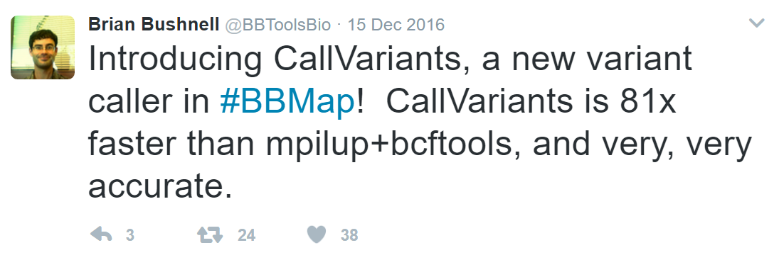
callvariants
Calls variants from SAM or BAM input (sorted or unsorted).
In default mode, all input files are combined and treated as a single sample. In multisample mode, each file is treated as an individual sample and gets its own column in the VCF file.
Supports any ploidy level.
13 variant calling filters (depth, quality, distance to read end, read sequence identity, plus/minus strand ratio, allelle fraction, and more).

Slide 26
Other Utilities
shred
shreds sequences into shorter, potentially overlapping sequences
repair
re-pair disordered paired reads
stats
generates assembly statistics including scaffold count, N50, L50, GC content & gap percent
taxonomy
designed for processing NCBI taxonomy information

Slide 27
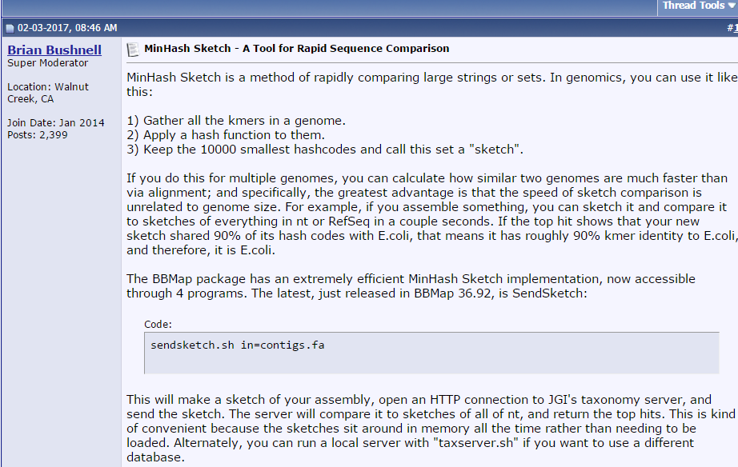
sketch

Slide 28
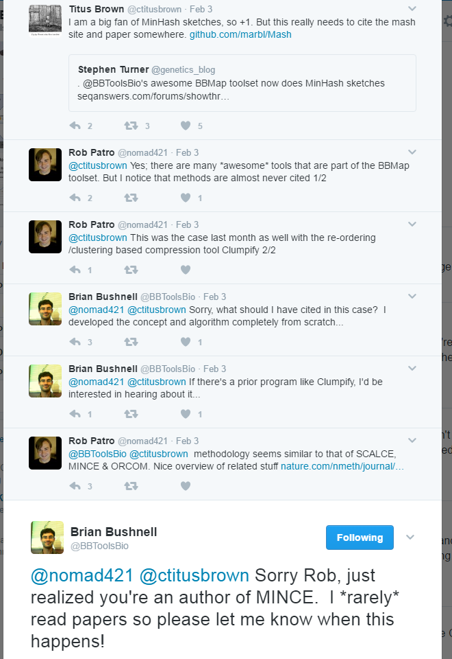

Slide 29
